Slide 1
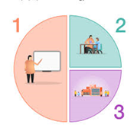
Releasing the Magic
This year we will be……
1. Continuing to make sure you can do your best
and achieve well
2. Supporting you with different ways to show what you have learnt
3. Giving you extra special opportunities to help
you be ready as you grow up
(School Development Plan 2023-2024)

